Slide 1

EEE-2421: Electrical Drives and Instrumentation Credit Hours - 2 Segment - 4
Saif Sabbir
Lecturer
Department of CSE
International Islamic University Chittagong (IIUC)
Spring 2026

Slide 2
AC Motor

Slide 3
Introduction
An induction motor is also known as the asynchronous motor.
It is basically an AC motor that runs lower than synchronous speed.
They operate on the principle of electromagnetic induction.
They can run either as induction motors or as induction generators.

Slide 4
Introduction
Synchronous speed is the speed at which the magnetic field produced by the stator of an induction machine rotates.
It is directly proportional to the frequency of the given AC power supply.
Traditionally used for constant-speed service, but can be used in variable-speed applications using variable-frequency drives (VFD).
Induction motors are simple, rugged, low-priced, easy to maintain and most suited for industrial requirements.

Slide 5
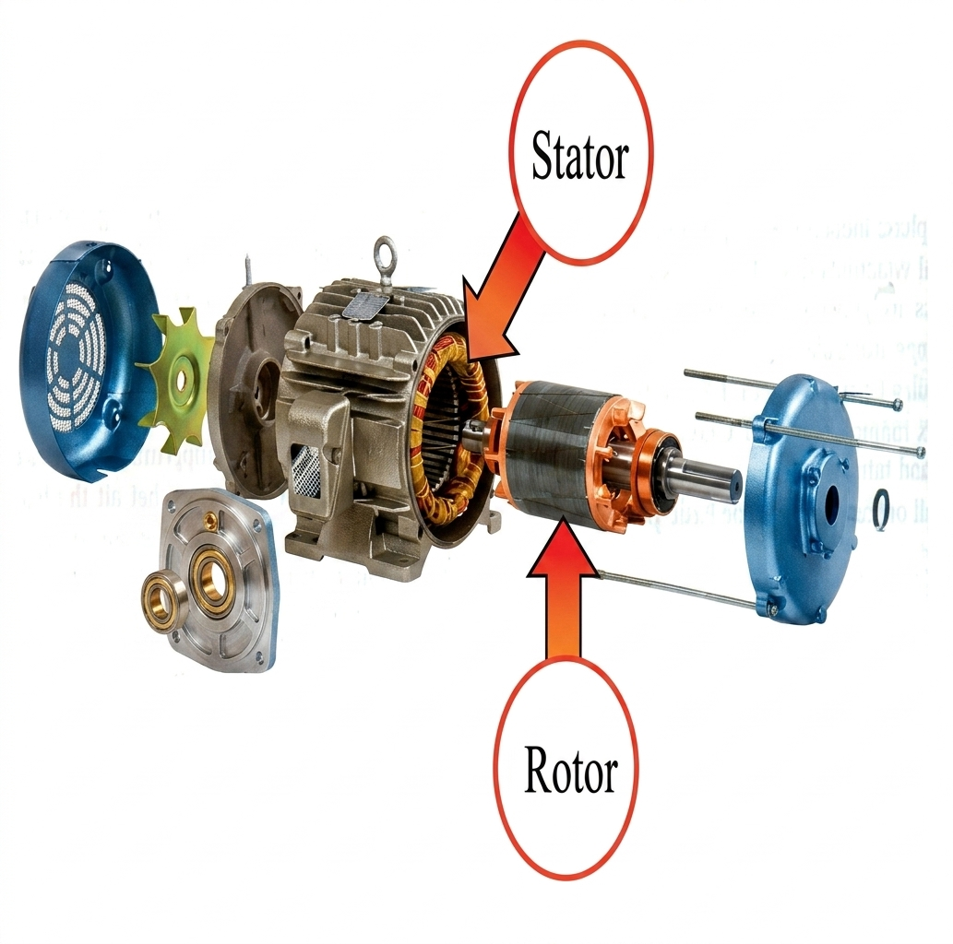
3-phase Induction Motor
Stator
It consists of a steel frame which encloses a hollow, cylindrical core made up of thin laminations of silicon steel.
A number of evenly spaced slots are provided on the inner periphery of the laminations.
Rotor
The rotor, mounted on a shaft, is a hollow laminated core having slots on its outer periphery.
The winding placed in these slots (called rotor winding) may be one of the following two types:
(i) Squirrel cage type (ii) Wound type

Slide 6
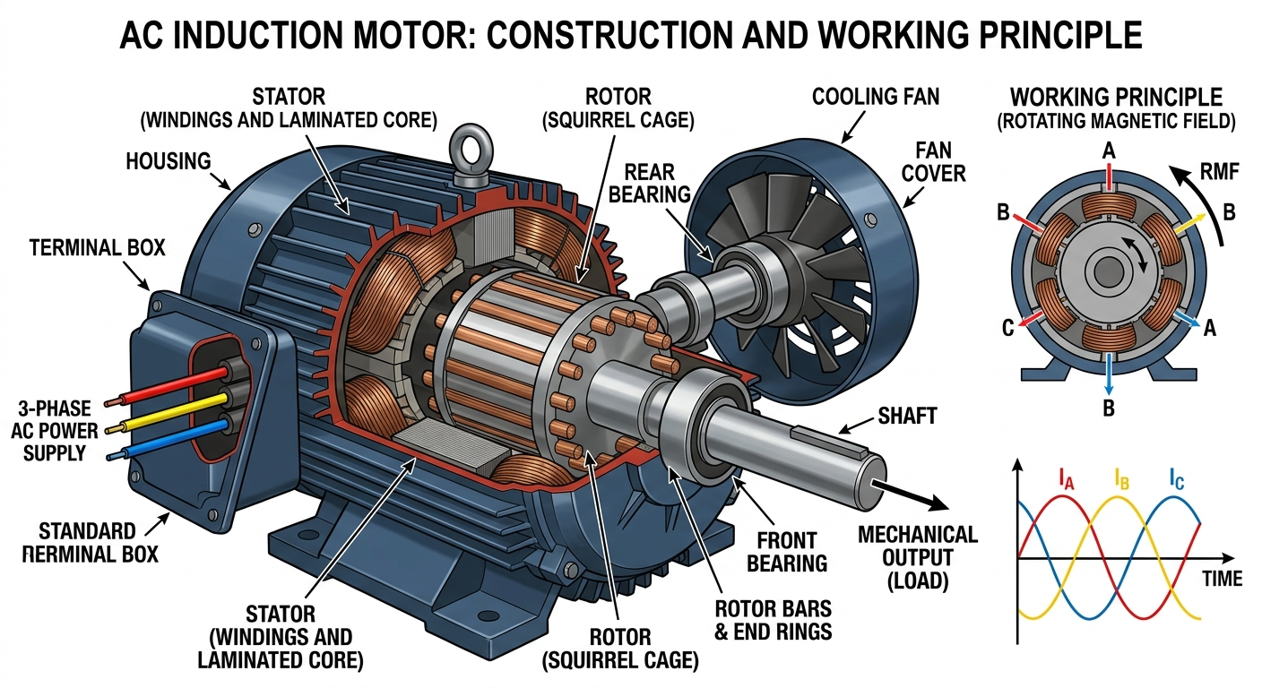
3-phase Induction Motor

Slide 7
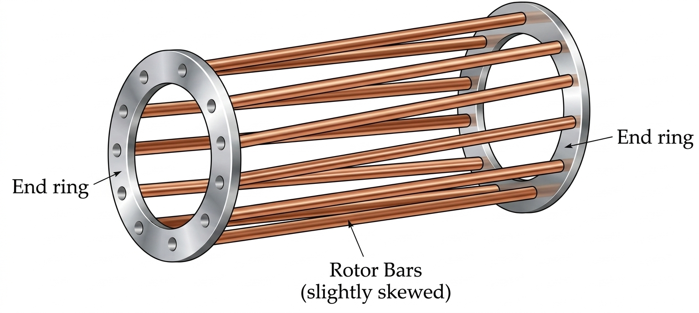
Squirrel Cage Rotor
It consists of a laminated cylindrical core having parallel slots on its outer periphery.
Each slot connects an Al or Cu bar and these bars are short-circuited by a metal ring on the other end.
This entire construction forms a squirrel cage, hence the name.
As the rotor bars are permanently short-circuited, it has low starting torque.

Slide 8
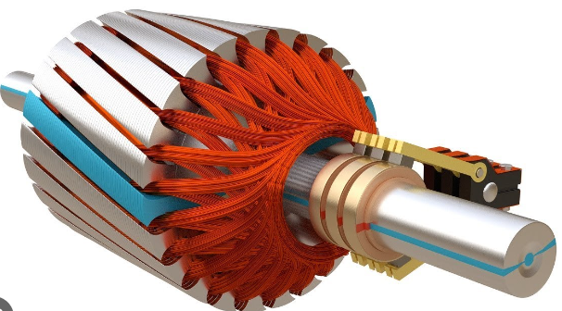
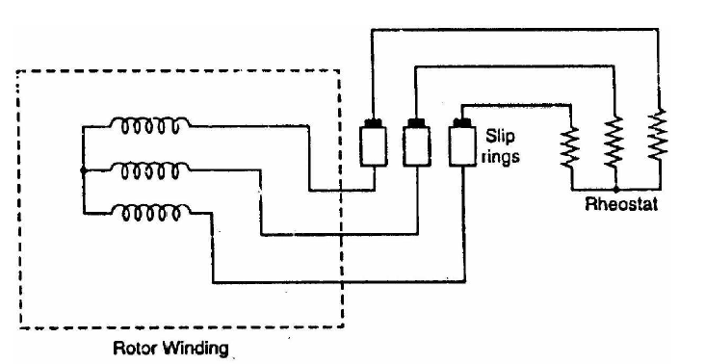
Wound Type Rotor
It consists of a cylindrical laminated core and carries 3 phase winding.
Open ends of the rotor winding are joined to 3 insulated slip rings mounted on rotor
shaft with carbon brush resting on each. Brushes are connected to 3 phase rheostat.
At starting, the external resistances are included in the rotor circuit to give a
large rotating torque.
Rheostats are gradually reduced to zero as the motor runs up to normal speed.

Slide 9
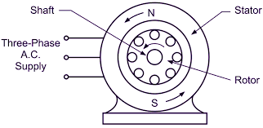
Principle of Operation
When 3-phase stator winding is energized from a 3-phase supply, a rotating magnetic field is set up which rotates around the stator at synchronous speed.

Slide 10
Principle of Operation
The rotating field passes through the air gap and cuts the rotor conductors, which are still stationary. Due to the relative speed between the rotating flux and the stationary rotor, e.m.f. are induced in the rotor conductors. Since the rotor circuit is short-circuited, currents start flowing in the rotor conductors.
As the current-carrying rotor conductors are placed in the magnetic field produced by the stator, mechanical force acts on the rotor conductors. The sum of the mechanical forces on all the rotor conductors produces a torque. As the rotor tries to catch the RMF speed it tends to move the rotor in the same direction as the rotating field. But rotor never reaches the speed.

Slide 11
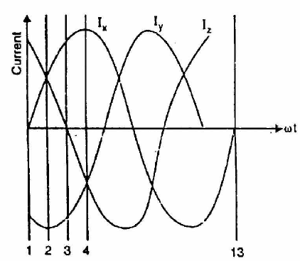
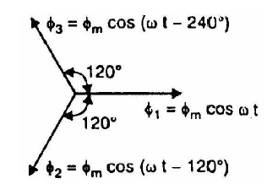
Rotating Magnetic Field
When a 3-phase winding is energized, a rotating magnetic field is produced. This field is such that its poles do not remain in fixed positions on the stator but go on shifting their positions around the stator. The speed at which it rotates, is called the Synchronous speed (Ns).

Slide 12
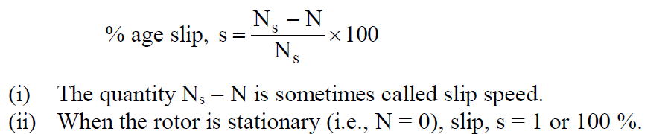
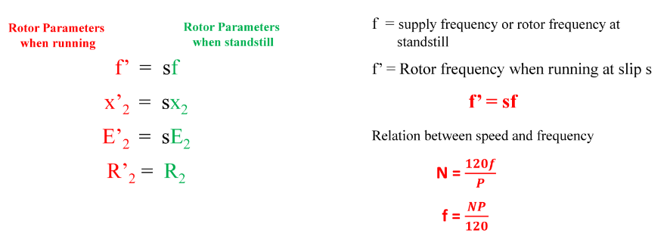
Effects of Slip
The difference between the synchronous speed Ns of the rotating magnetic field and the actual rotor speed N is called slip. It is usually expressed as a percentage of synchronous speed.

Slide 13
Single-Phase Induction Motors
A single-phase induction motor is very similar to a 3-phase squirrel cage Induction Motor.
It consists of-
squirrel-cage rotor identical to a 3-phase motor
single-phase winding on the stator
Single-phase induction motor is not self-starting.

Slide 14
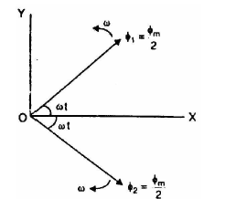
Single-Phase Induction Motors
Single-phase induction motor is not self-starting.
Double Field Revolving Theory.
When the rotor is stationary and the stator winding is connected to a single-phase supply, a magnetic field is produced that pulsates in a sinusoidal manner.
The alternating flux produced by the stator winding can be presented as the sum of two rotating fluxes, each equal to one-half of the maximum value of alternating flux and each rotating at synchronous speed in opposite directions.
If one flux rotate in anti clockwise direction and other flux rotates in clockwise direction. The fluxes will result in a production of one torque in the anti clockwise direction and other in the clockwise direction.
These two torques are equal and opposite and the net torque developed is zero.

Slide 15
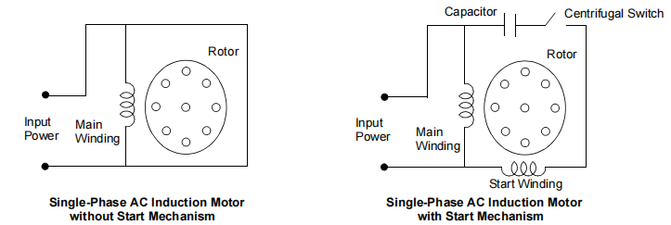
Single-Phase Induction Motors
The starting mechanism of the single-phase induction motor is mainly an additional stator winding (start/ auxiliary winding) as shown in Figure. The start winding can have a series capacitor and/or a centrifugal switch. When the supply voltage is applied, current in the main winding lags the supply voltage due to the main winding impedance. At the same time, current in the start winding leads/lags the supply voltage depending on the starting mechanism impedance. Interaction between magnetic fields generated by the main winding and the starting mechanism generates a resultant magnetic field rotating in one direction. The motor starts rotating in the direction of the resultant magnetic field.
Once the motor reaches about 75% of its rated speed, a centrifugal switch disconnects the start winding. From this point on, the single-phase motor can maintain sufficient torque to operate on its own.

Slide 16
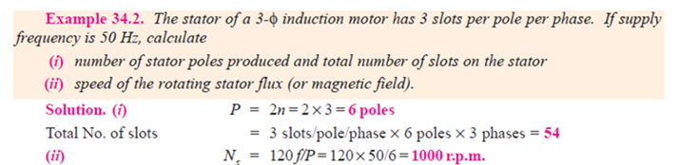
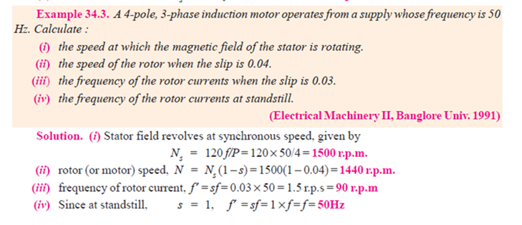
Numerical Problems

Slide 17
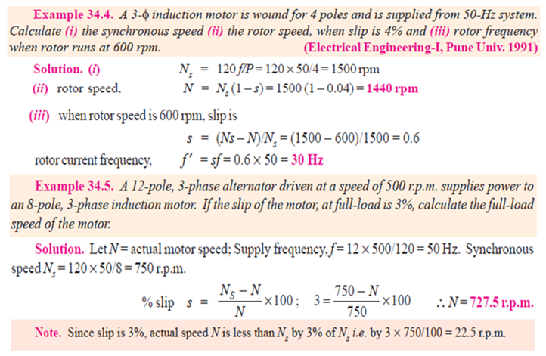
Numerical Problems

Slide 18
Variable Frequency Drive (VFD)
The VFD is a system made up of power electronics devices (IGBT, MOSFET, etc.), a high speed central controlling unit (a microcontroller, like the PIC18 or the PIC16) and optional sensing devices, depending upon the application requirement.
The basic function of the VFD is to act as a variable frequency generator in order to vary speed of the motor as per the user setting.

Slide 19
Why is VFD important?
Avoids Over-design: Without a drive, motors are often oversized to handle peak loads, wasting energy during normal operation.
Variable Speed Control: For loads like fans and pumps, power consumption is proportional to the cube of the speed. A drive allows you to reduce speed slightly, which can cut power usage by up to 50%.
Eliminates Throttling: Instead of using mechanical valves (which waste energy via friction/heat) to limit flow, the drive simply slows down the motor.
Soft Starting: Induction motors draw massive "inrush" currents at startup (causing voltage dips and heat stress). Drives provide a controlled ramp-up, protecting the motor insulation and the local grid.
Power Factor Correction: At light loads, induction motors have a very poor PF (around 0.1). Modern drives help maintain a better PF, preventing utility companies from imposing financial penalties on industrial users.

Slide 20
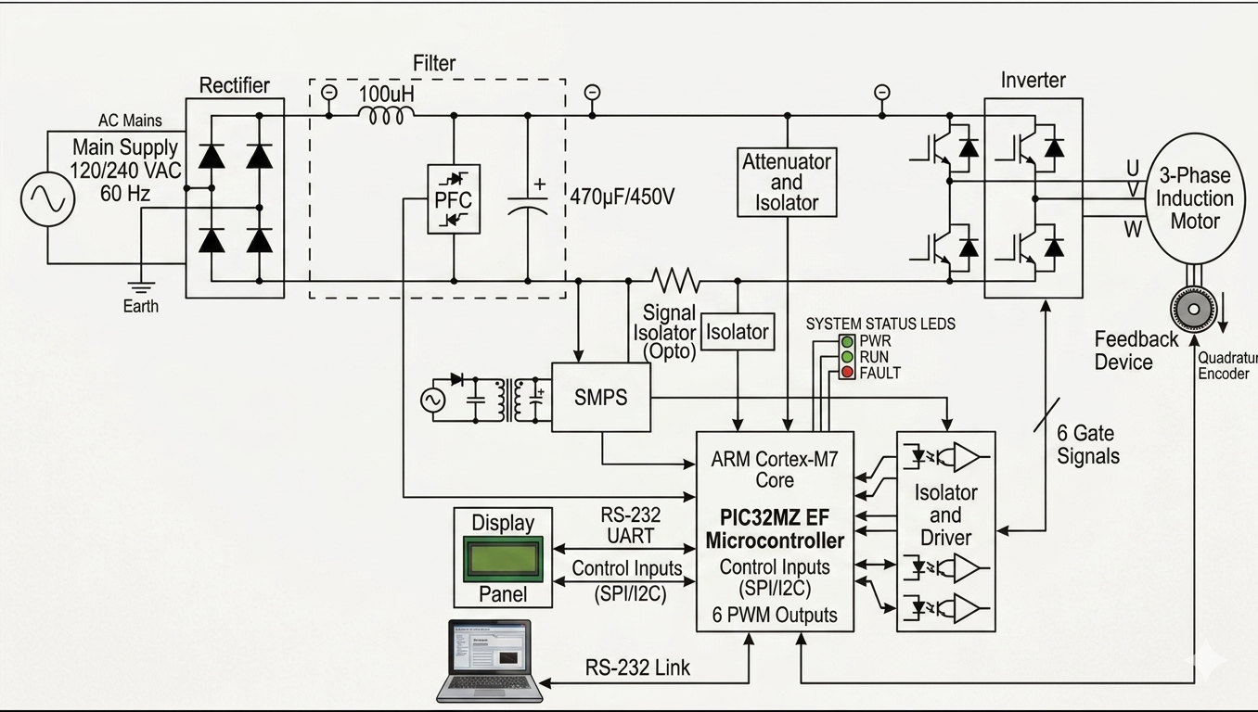
Variable Frequency Drive (VFD)

Slide 21
Variable Frequency Drive (VFD)
Rectification
AC Main Supply: Provides the primary electrical power (120/240 VAC).
Rectifier: Uses a a bridge rectifier configuration using four diodes to convert the incoming AC into DC.
The Filter Section
Inductor acts to smooth out current ripples and filter out high-frequency noise.
PFC (Power Factor Correction): Improves the efficiency of the power supply by ensuring unity power factor.
Capacitor ($470\mu F / 450V$): further smooths the DC voltage to provide a stable DC supply for the inverter.
Control & Processing
PIC32MZ EF Microcontroller : The "brain" of the system. It processes feedback, executes control algorithms, and generates the 6 PWM (Pulse Width Modulation) Outputs needed to drive the motor.
Motor Drive & Feedback
Isolator and Driver: Amplifies the low-power PWM signals from the MCU to high-power levels capable of switching the Inverter’s transistors. It provides electrical isolation between the logic and power stages.
Inverter: Uses six IGBTs or MOSFETs to switch the DC bus voltage into a 3-phase AC output. By varying the timing, it controls the speed and torque of the motor.
Feedback Device (Quadrature Encoder): Attached to the motor shaft. It sends real-time position and speed data back to the microcontroller to enable "Closed-Loop" control.
Logic Power & Sensing
SMPS (Switched-Mode Power Supply) steps down the high DC bus voltage to low-voltage DC (e.g., 3.3V or 5V) to power the microcontroller and Signal Isolator (Opto), Attenuator and Isolator maintains a safety mechanism so that the microcontroller can monitor the voltage without being damaged.

